Slide 1
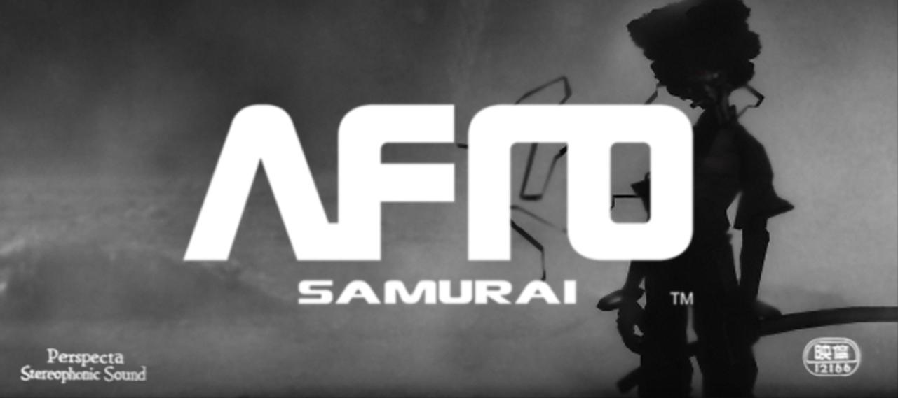
Notes:
Style in Rendering: The History and Technique behind Afro Samurai's Look

Slide 2

STYLE IN RENDERING
THE HISTORY AND TECHNIQUES BEHIND AFRO SAMURAI’S LOOK
DANIEL CHAN
BRYAN JOHNSTON
Notes:
D: Welcome to Style in Rendering: The History and Technique behind Afro Samurai's Look
D: This talk is split into two parts.
D: The first part is about the evolution of Afro's look working with licensors.
D: The second part covers the techniques involved in bringing that look to life.
Introduction
D: I’m Daniel Chan, Crystal Dynamics to Naughty Dog to Internet to Independent Games to Afro Samurai, now at EA
B: I’m Bryan Johnston, I started off as an artist at Activision, and came to Namco were I was the Art Lead on Afro and was responsible for the overall look and feel of the game.
Afro Intro
B: What is Afro Samurai?

Slide 3
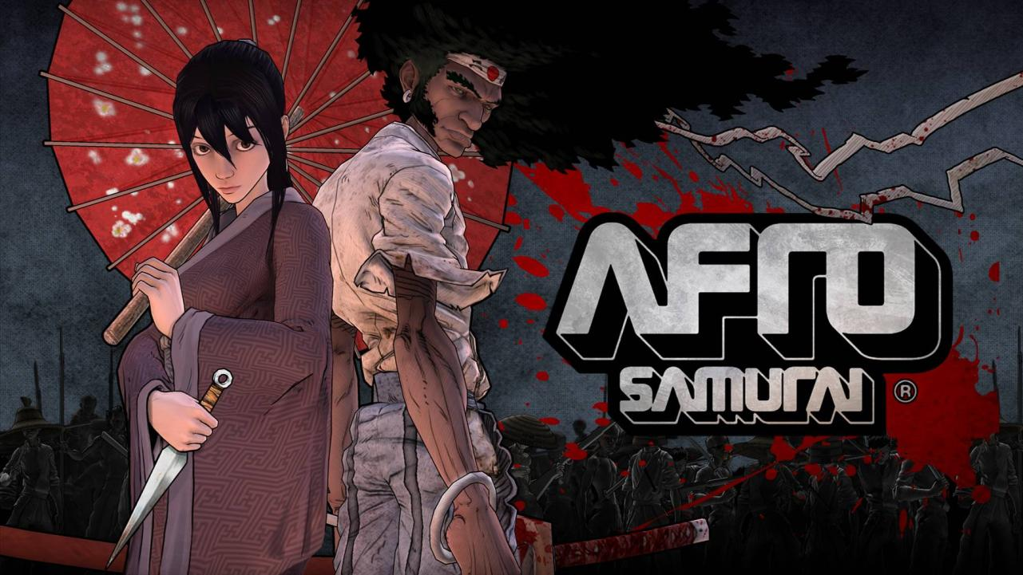
Notes:
B: This is our vision of Afro and this is Afro in the videogame, but there's a story behind the long journey to get to this Afro.

Slide 4
THE STORY OF AFRO
*WARNING: SPOILERS AHEAD*
Notes:
4
B: I’d like to start things off by quickly summarizing the story of Afro.
B: This is the version I tell to my kids at night.
B: So it may have content inappropriate for adults. Just be warned.

Slide 5
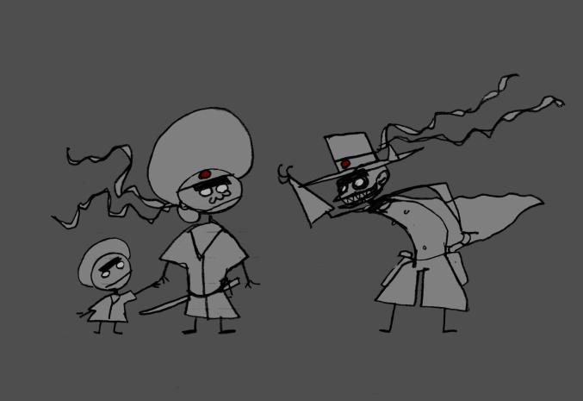



Afro’s Father was the number one fighter in the world.
Afro’s Father was a God.
Justice was the Number Two.
Only the Number Two can challenge the Number One.
Notes:
Afro’s Father was the number one fighter in the world.
Afro’s Father was a God.
Justice was the Number Two.
Only the Number Two can challenge the Number One.
5

Slide 6
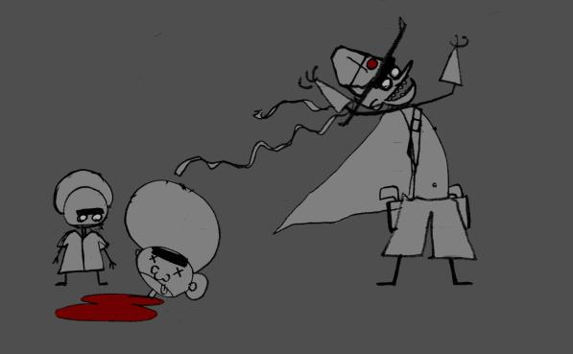
Justice killed Afro’s Father in a duel.
“You can challenge me when you’re ready,” said Justice,
“but you’ll need the Number Two Headband.”
Notes:
Justice killed Afro’s Father in a duel.
“You can challenge me when you’re ready,” said Justice,
“but you’ll need the Number Two Headband.”
6

Slide 7
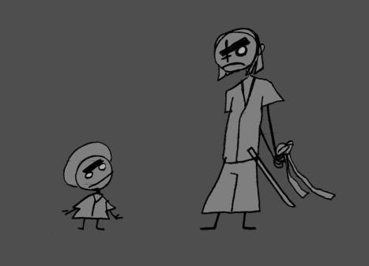
Afro was found by the Sword Master, who raised him like his son.
But Sword Master had a secret – he had the Number Two headband.
Sword Master hid the headband from Afro.
Notes:
Afro was found by the Sword Master, who raised him like his son.
But Sword Master had a secret – he had the Number Two headband.
7

Slide 8
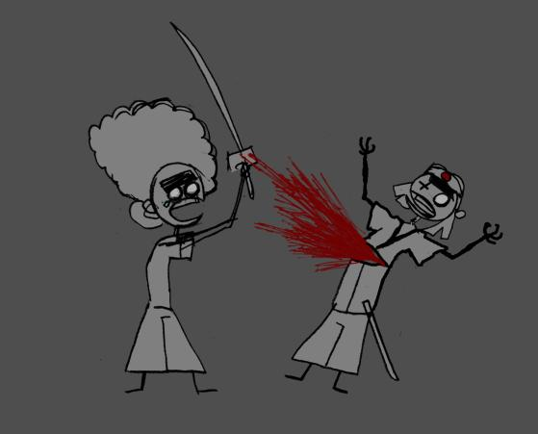
When he found out Afro killed his master and took the headband.
Afro wanted revenge for his Father’s death.
With his imaginary friend Ninja Ninja Afro set out to find Justice.
Notes:
When he found out Afro killed his master and took the headband.
Afro wanted revenge for his Father’s death.
With his imaginary friend Ninja Ninja Afro set out to find Justice.
8

Slide 9
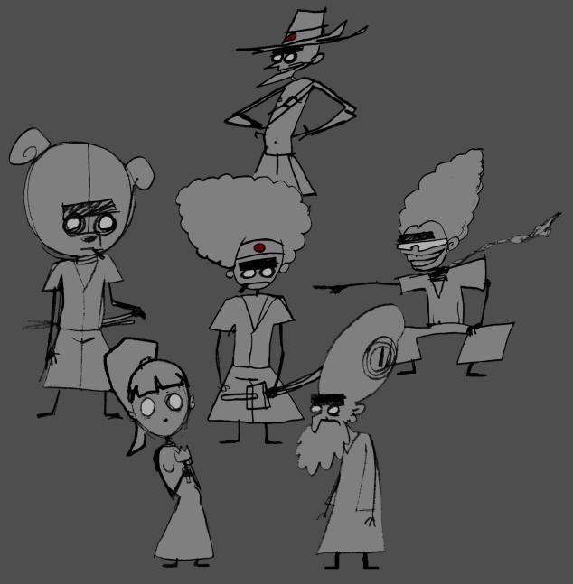
They had many adventures…
Notes:
They had many adventures…
9

Slide 10
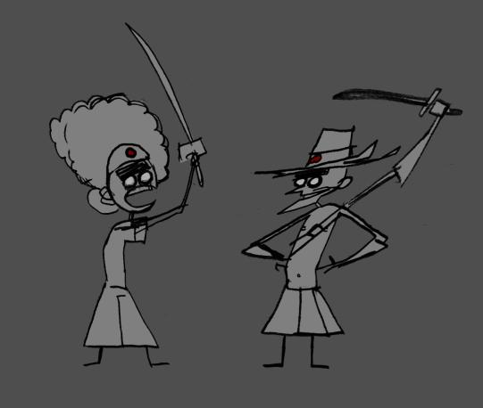
At last Afro found his Father’s killer.
But Justice had a surprise in store for Afro.
Justice had killed Afro’s Father with a hidden knife.
Justice had cheated.
Notes:
At last Afro found his Father’s killer.
But Justice had a surprise in store for Afro.
Justice had cheated.
10

Slide 11
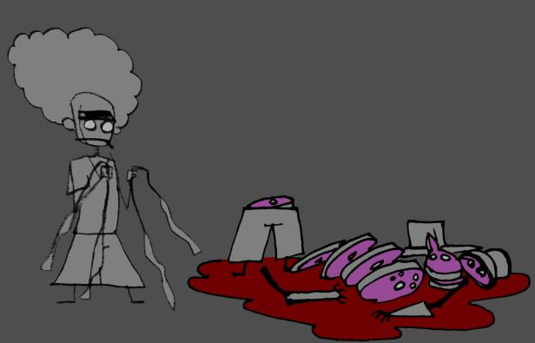
But Afro beat Justice anyway;
he was that good.
Afro was left with the two headbands
And a decision to make…
Notes:
But Afro beat Justice anyway;
he was that good.
Afro was left with the two headbands
And a decision to make…
11

Slide 12
THE END
Notes:
12
So kids, the moral of the story is ‘if you mess with Dad, eventually you’ll get your butt kicked’.

Slide 13
A BRIEF HISTORY OF AFRO
Notes:
B: So were did this crazy little story of Afro begin?
B: Well it had a kind of grass roots beginning.
B: In 1998 After college Okazaki and his friends self published an independent Dojin magazine called Nou Nou Hau.
B: This was a way for them to get there art out on their own terms.

Slide 14
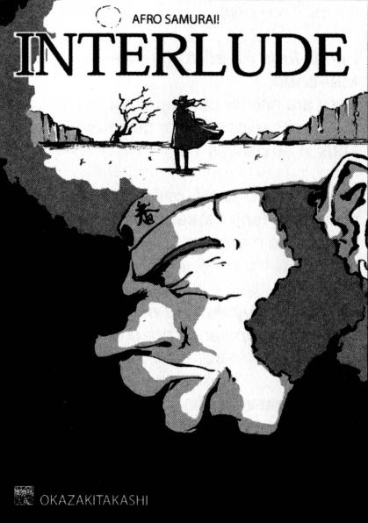
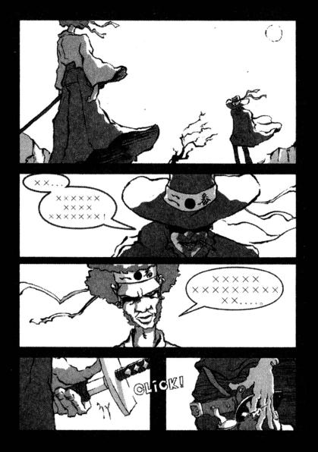
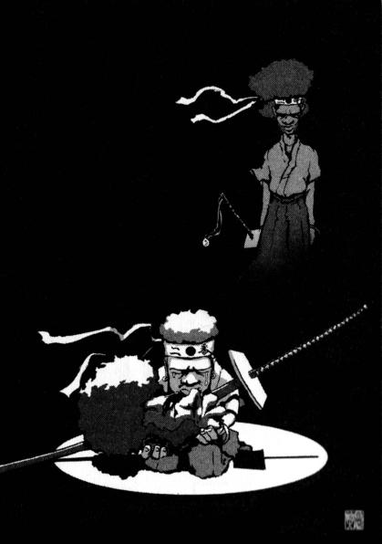
© 2006 TAKASHI OKAZAKI, GONZO / SAMURAI PROJECT
Notes:
B: The cover of issue 0 featured Afro Samurai. Here are some panels from that issue.
B: Also a limited run toy was produced in this likeness

Slide 15
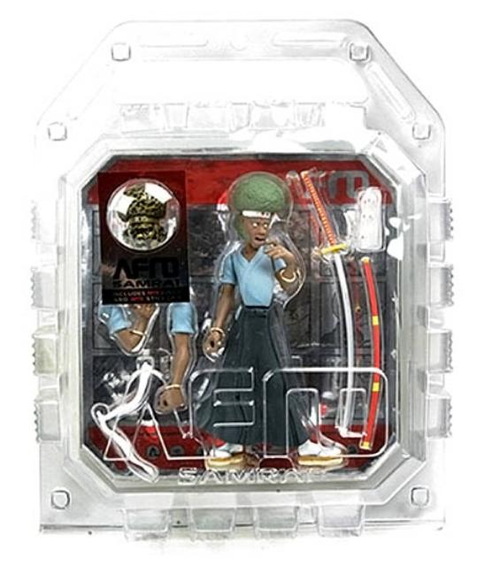
Notes:
B: The toy was noticed by Eric Calderon at a friend’s house.
B: Eric at that time was Director of Creative Affairs at Gonzo which is the studio that eventually produced the anime.
B: Here’s a short clip from the anime.

Slide 16
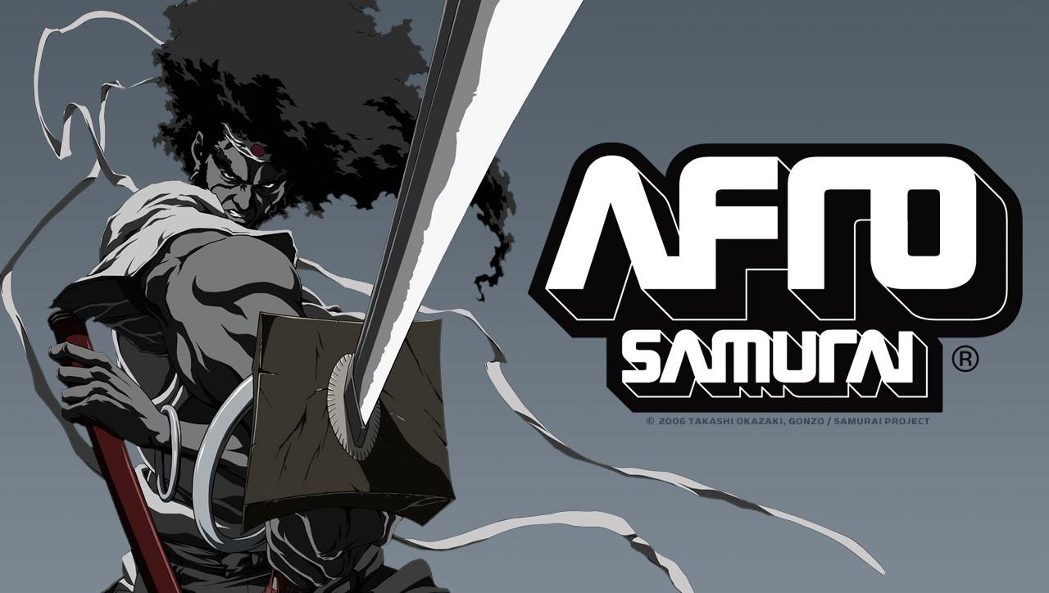
Notes:
B: But before that, they had a pilot made that they shopped around to get some backing.
B: As the story goes Samuel L Jackson got a hold of a copy of the pilot.
B: He called up Eric and said… “I’m Afro Samurai”

Slide 17
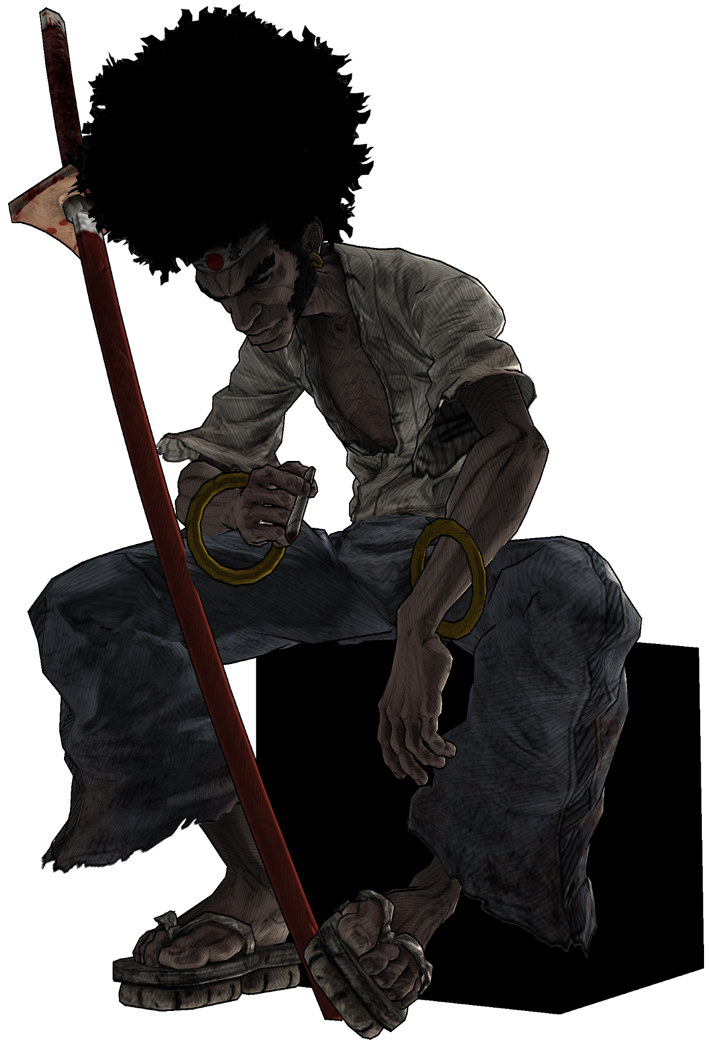
Notes:
B: The Afro pilot made its way to Namco were Mark Brown one of the producers there kept trying to show it to Dave Robinson who was our producer.
B: Dave thought the title was kind of silly so he kept putting it off, but when he finally saw it he was completely blown away.
B: And that’s when it began its life as a videogame.

Slide 18
DANNY’S STORY
Notes:
D: Here’s how I first heard about Afro Samurai.
D: David Robinson called me up and asked me see something.
D: Told me about a project by Gonzo Studios.
D: Dave is always excited.
D: I watched a short trailer for Afro and it knocked me on my ass.
D: The trailer is the inspiration and the reason why many of the core people on the team joined.
D: Unfortunately, we can't show that trailer.
D: Still, I had my doubts. Would Namco really do this license justice? A license like Afro would need to take risks
D: Then, Dave Robinson showed me a presentation that Paul Gardner and Duke Mighten had put together. And it was obvious that they "got it".

Slide 19
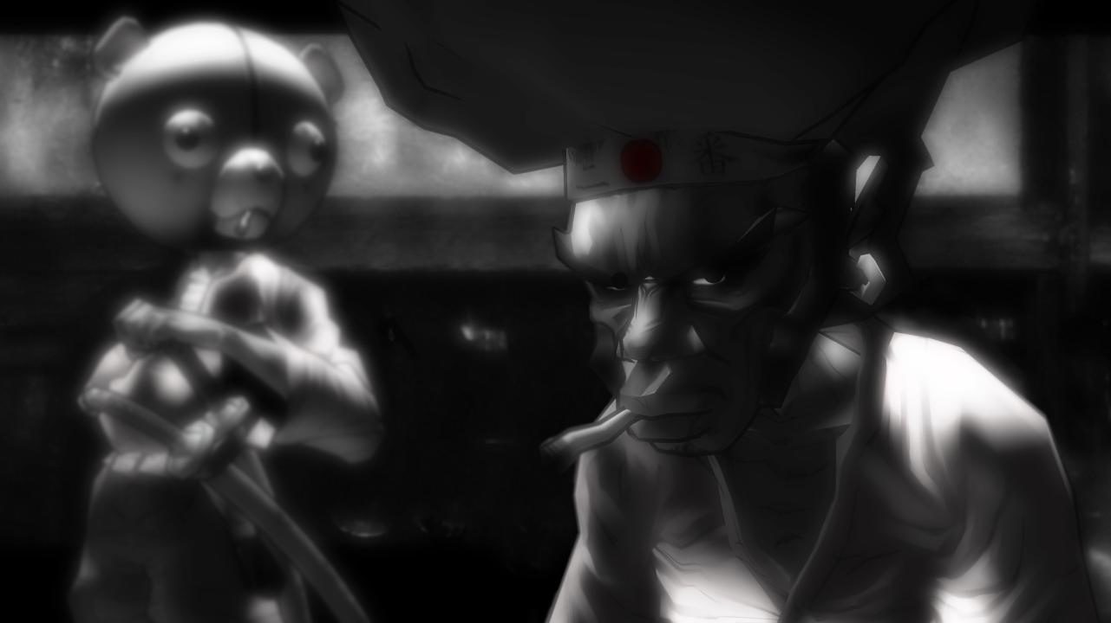
Notes:
D: Look at this! This was in an early style guide. It's in B&W! Beautiful moody bloom effect that conjures old school Samurai flicks.
D: Sign me up!

Slide 20
BRYAN’S STORY
Notes:
Bryan’s Story…
20

Slide 21
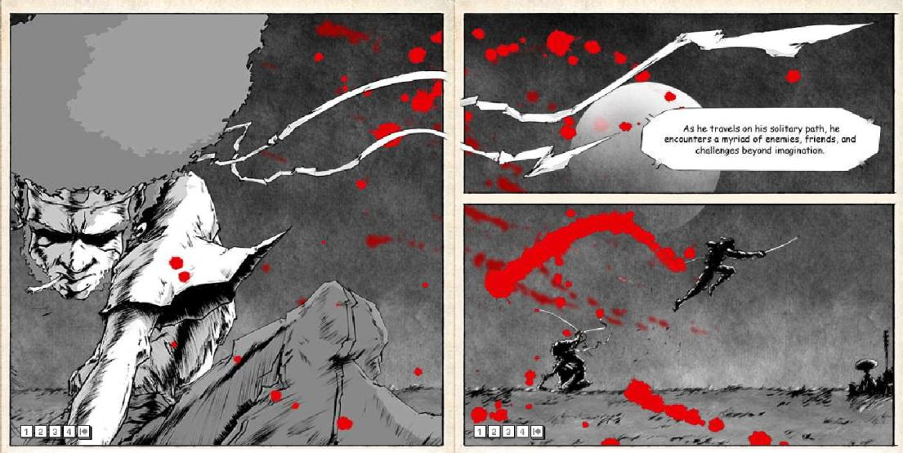
© 2006 TAKASHI OKAZAKI, GONZO / SAMURAI PROJECT
Notes:
B: This is an image from the original Afro website long before it was ever made into an anime, or videogame.
B: I originally saw this some two years prior to ever working on the game.
B: I just remember looking through the website and thinking man there’s some really cool ideas here.
B: And then two years later I met up with Dave he told me about the project and showed me that same pilot.
B: I was floored.

Slide 22
WORKING WITH LICENSORS
Notes:
B: But I had worked on licensed projects in the past and it’s not always the most pleasant experience.
B: Usually when more parties get involved and more money is at stake, it can have a kind of constricting effect.
B: But that wasn’t so much the case here.
B: I think a few things helped to contribute to that.

Slide 23
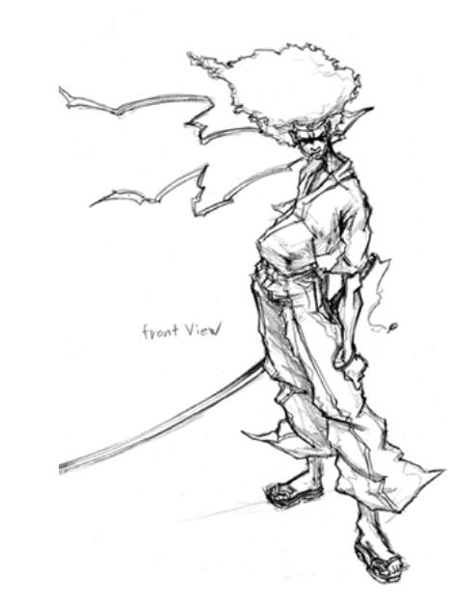
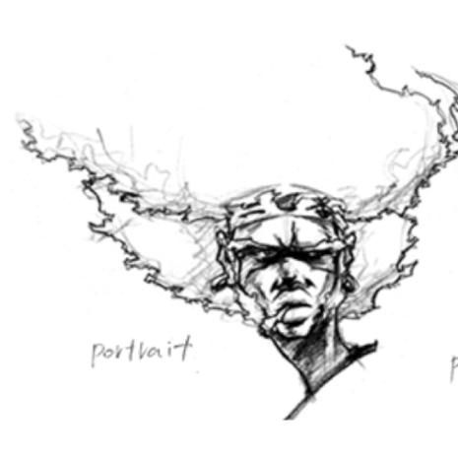
© 2006 TAKASHI OKAZAKI, GONZO / SAMURAI PROJECT
Notes:
B: For one we had identified and agreed on the appropriate points at which to solicit feedback.
B: It was agreed upfront that Gonzo would have input on both story and art.
B: It also helped that Gonzo came from a place of understanding.

Slide 24
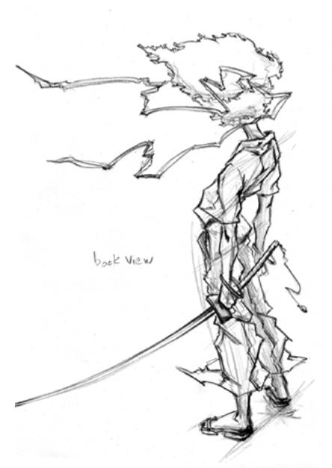
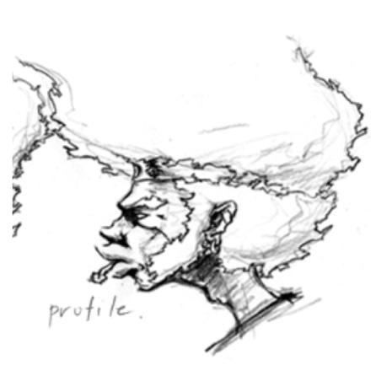
© 2006 TAKASHI OKAZAKI, GONZO / SAMURAI PROJECT
Notes:
B: They themselves had to make the transition from Manga to Anime.

Slide 25
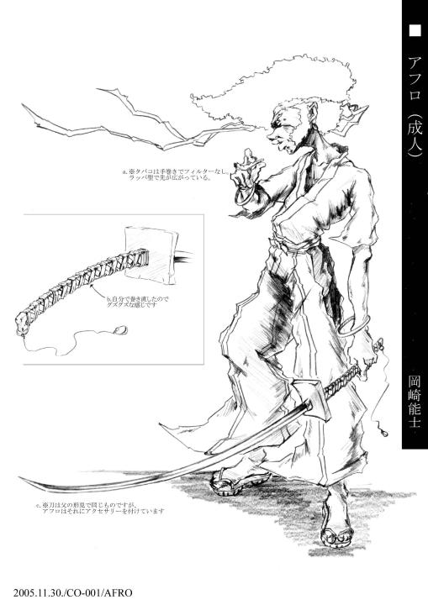
© 2006 TAKASHI OKAZAKI, GONZO / SAMURAI PROJECT
Notes:
B: Here is Okazaki’s Afro done on behalf of Gonzo.

Slide 26
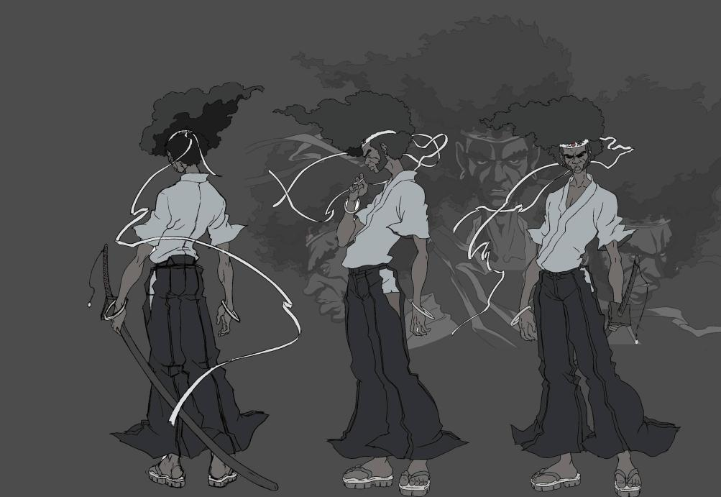
© 2006 TAKASHI OKAZAKI, GONZO / SAMURAI PROJECT
Notes:
B: And here is Anime Director Kizaki’s interpretation of Afro.

Slide 27
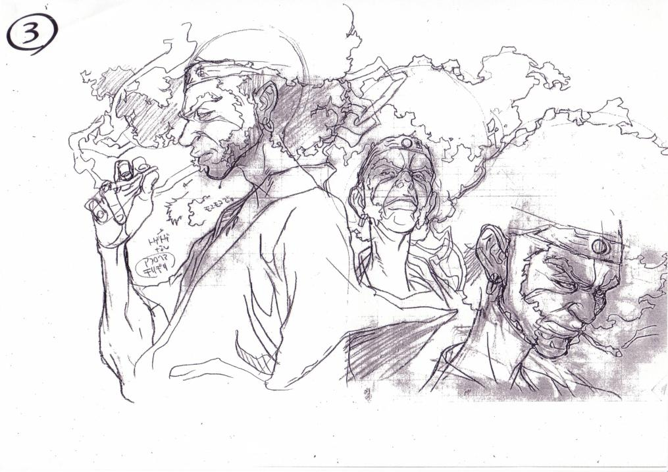
Notes:
B: Gonzo understood that some changes would have to be made to best suit the medium.

Slide 28
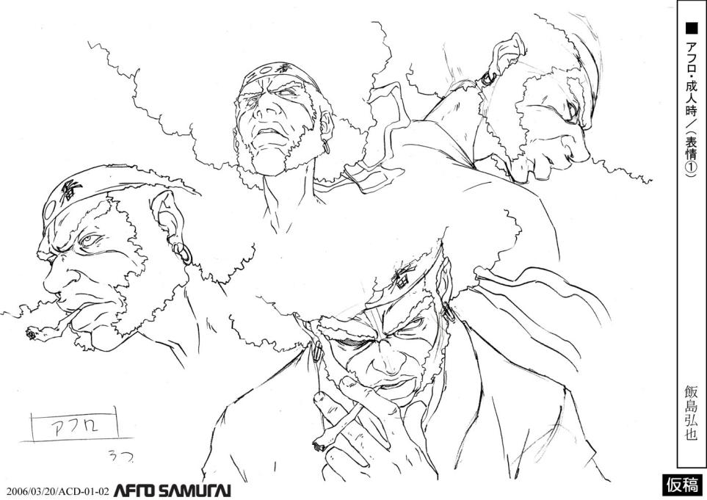
© 2006 TAKASHI OKAZAKI, GONZO / SAMURAI PROJECT
Notes:
B: In their case it meant things like simplifying some of the pen and ink look.

Slide 29
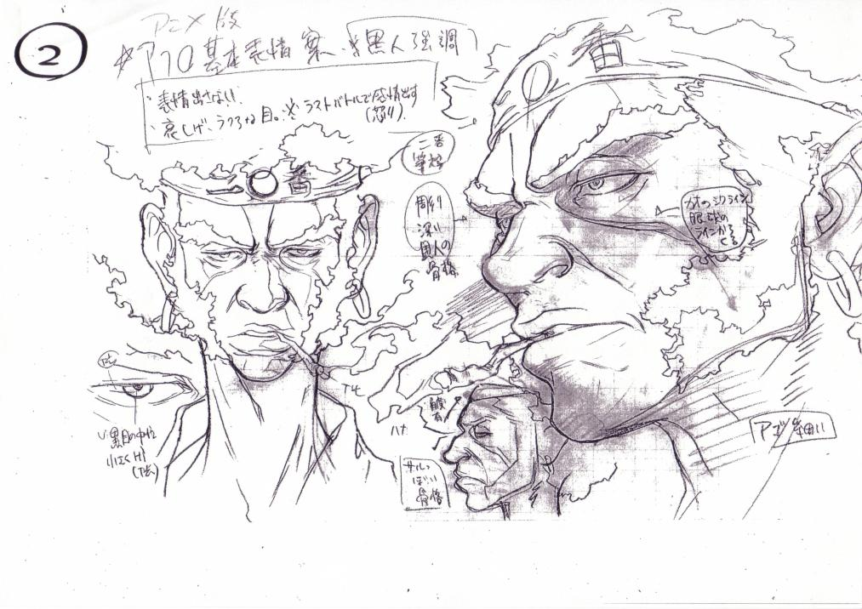
© 2006 TAKASHI OKAZAKI, GONZO / SAMURAI PROJECT
Notes:
B: Here are some notes they made for Okazaki explaining some of there changes.

Slide 30
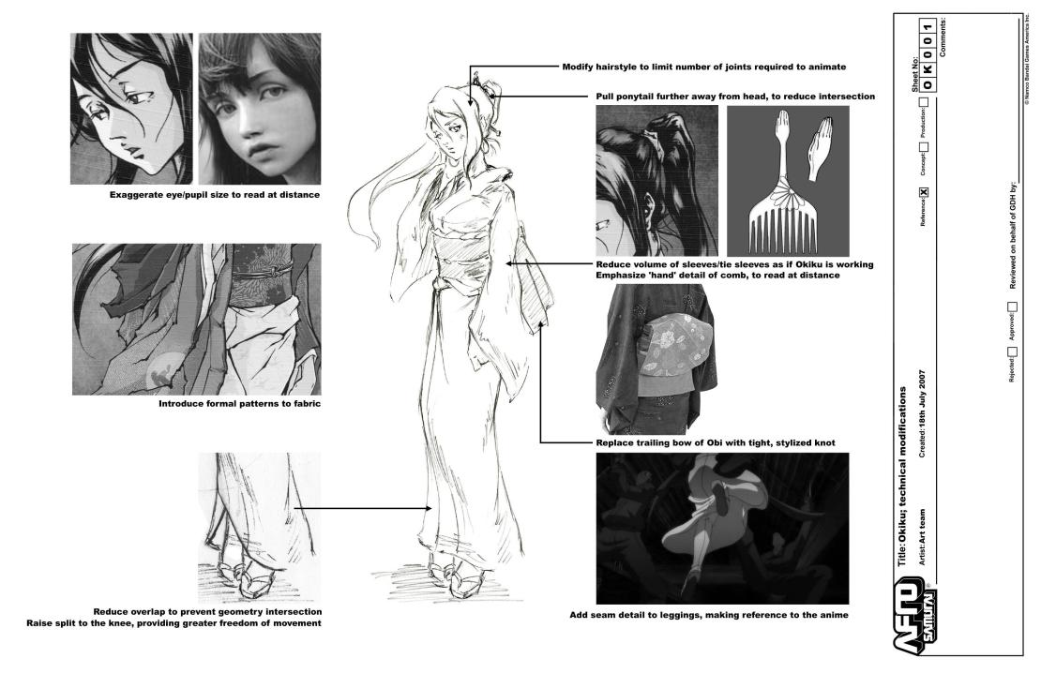
© 2006 TAKASHI OKAZAKI, GONZO / SAMURAI PROJECT
Notes:
B: Here we’ve done a similar thing to explain some of our changes to Gonzo.
B: We eventually formalized this process into what we called character sheets.
B: We would make notes on there drawings explaining some of the changes we may have to make,
B: either to fit the game aesthetic or because of technical limitations.

Slide 31
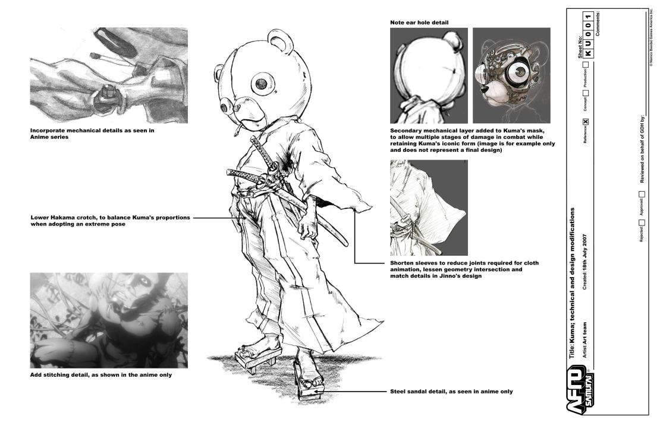
© 2006 TAKASHI OKAZAKI, GONZO / SAMURAI PROJECT
Notes:
B: Here’s a character sheet of Kuma.
B: Its important to acknowledge that some changes are necessary and beneficial.
B: Here we explain some of the details we planned to put in, like the hinges on Kuma’s elbow, and some of the inner workings of Kuma’s helmet.
B: We had the benefit of being able to add a lot of details that would have been incredibly difficult to maintain across an entire anime.
B: They understood that.
B: It was really our responsibility to give them the input they need to make informed decisions, and present changes as objectively as possible.
B: It looks like ass is probably not a good argument.
B: All this really helped us gain the licensor’s trust.

Slide 32
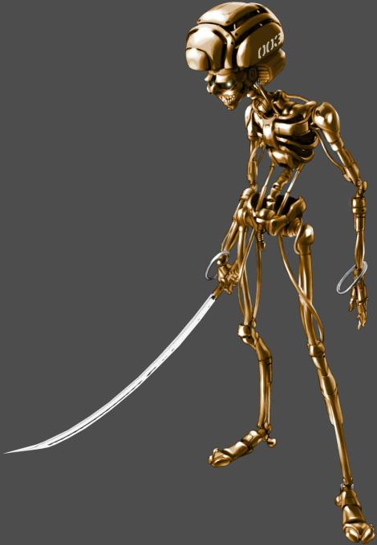
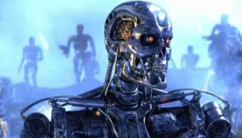
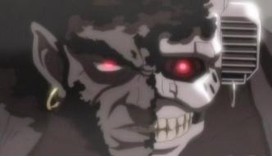
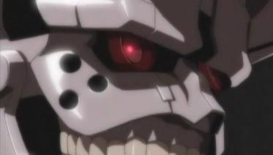
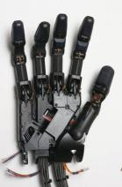
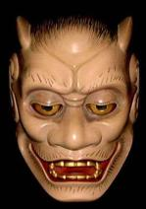
REFERENCES
Afro Droid can be seen as the T-100 from the 1984 movie ‘The Terminator’
His Afro Samurai façade will be based on a Noh mask resulting in a more impressionistic Afro double than an exact duplicate
Notes:
B: It Also helped to know what the original points of reference were.
B: This removed a level of abstraction.
B: Here’s an image from our style guide that shows Afrodroid and the original inspiration which was Terminator.
B: Because we knew what Okazaki’s references were, we were able to anticipate some of his design decisions, which meant that our new designs fit seamlessly into the Afro universe.

Slide 33
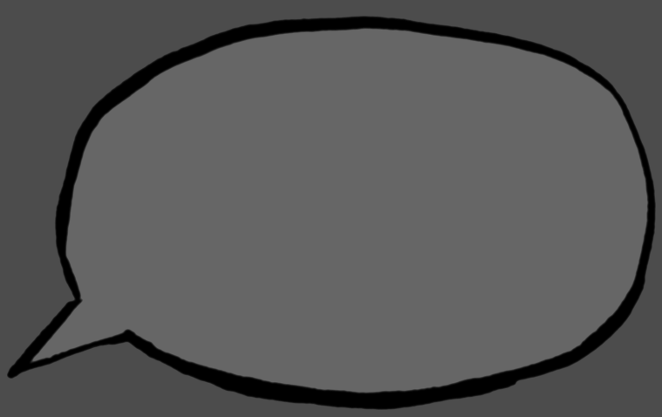
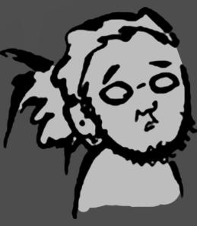
The doujinshi version of Afro Samurai, the current manga version, the anime version, and the game version all have slight differences from each other, but the core concepts remain the same. Each represents a unique world and story. Such multiple worlds exist within the Afro universe, and I allowed the series to be that way from the beginning.
Takashi Okazaki
Notes:
D: We were basing Afro off the Anime but we also wanted to stay true to the Manga.
D: Asked Okazaki his opinion. Okazaki said we were in better position to know what we needed for a videogame.
D: "Manga is different from Anime is different from videogame." Gave us artistic license.
D: Foresight: Okazaki even designed the Afro mythology to include alternate realities, so we were free to go our own way with the story.
D: This is a great lesson to licensors.
D: It made our jobs of creating this videogame a lot easier.

Slide 34
EVOLUTION OF AFRO
Notes:
B: So now we’re going to give a kind of macro overview of how Afro evolved as a game character…

Slide 35
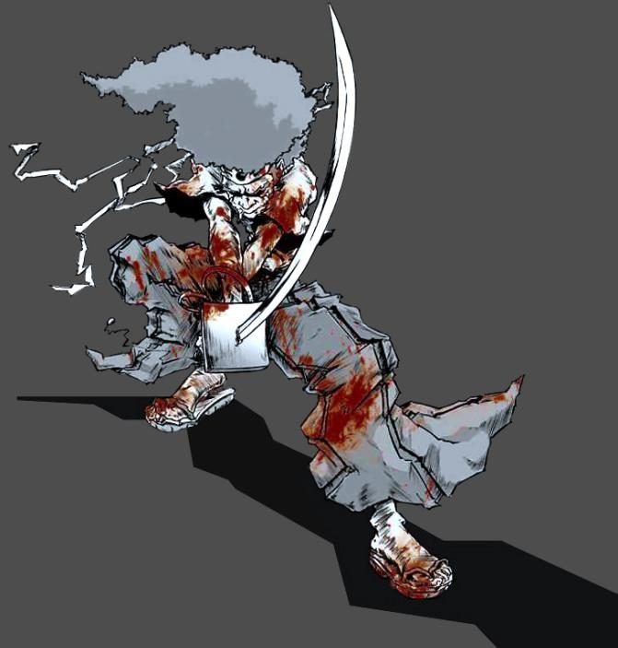
© 2006 TAKASHI OKAZAKI, GONZO / SAMURAI PROJECT
Notes:
B: From this…

Slide 36
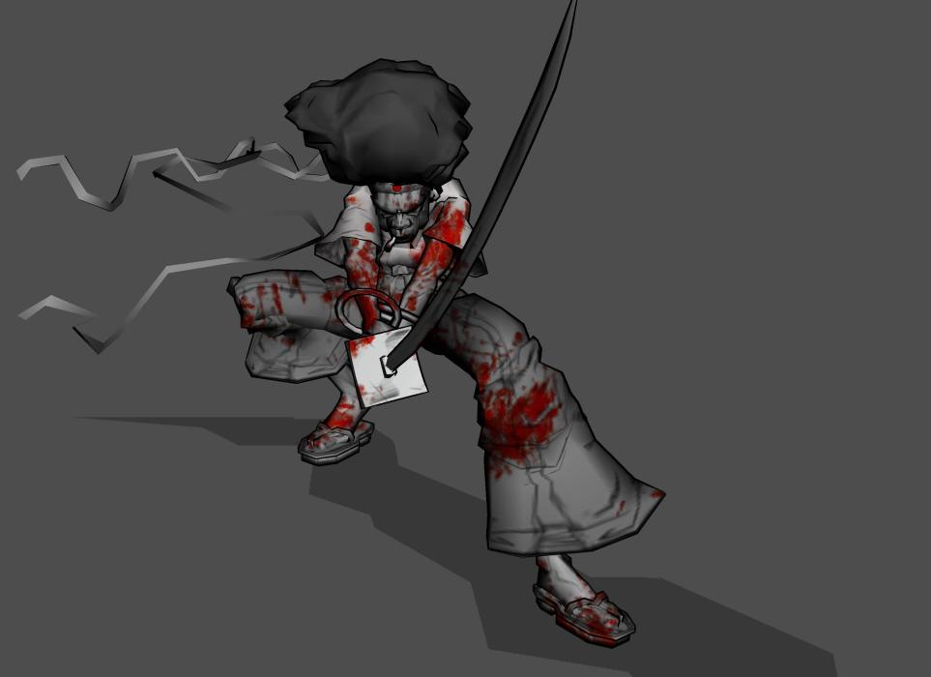
Notes:
…

Slide 37
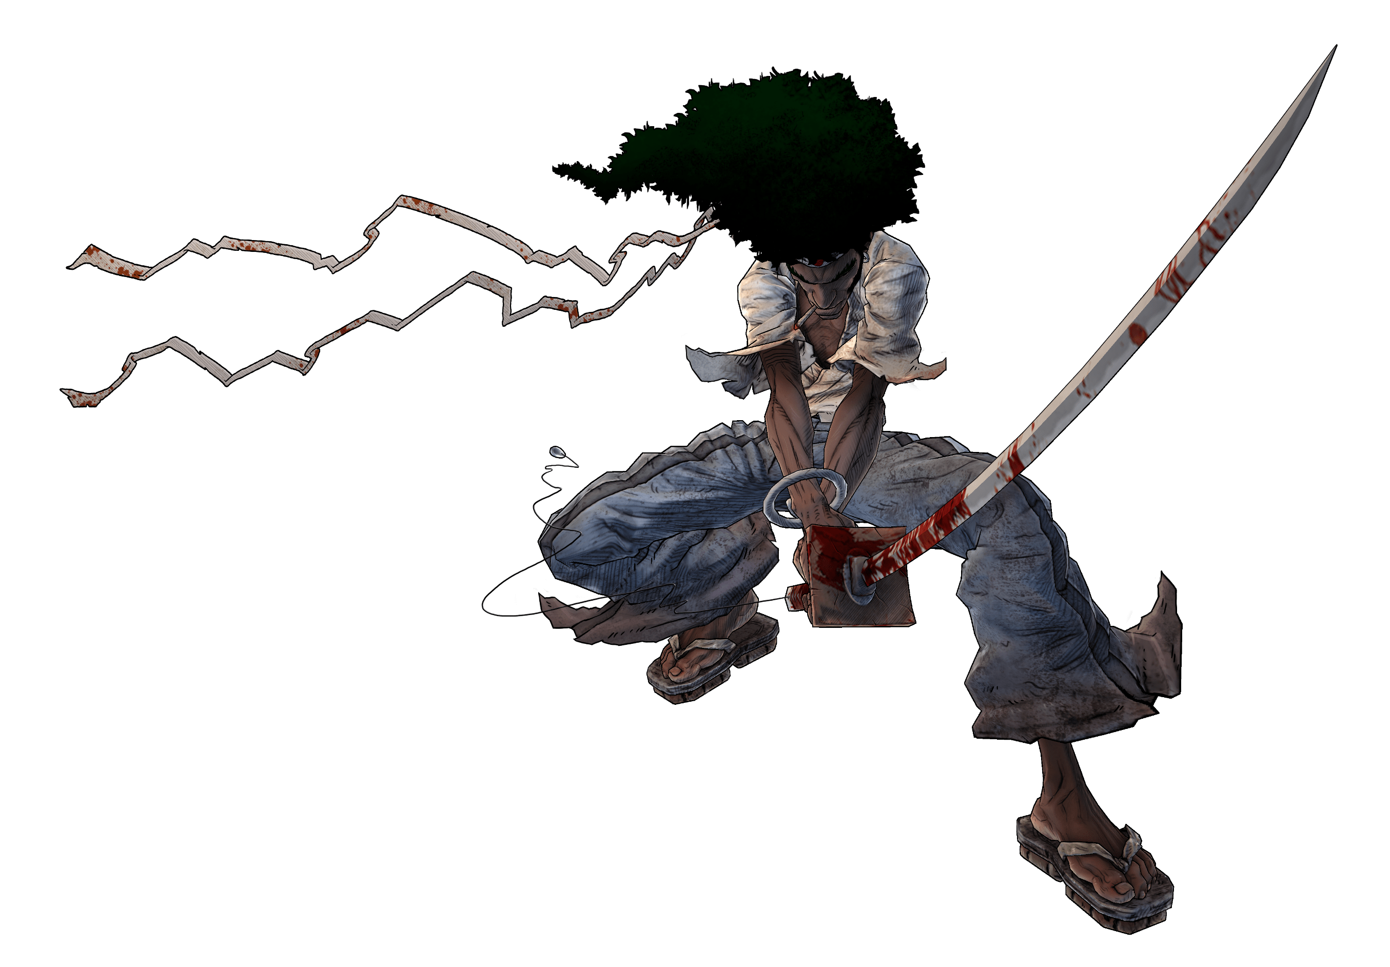
Notes:
B: …to this.
B: We’ll get into some more details about the final stages of the look later.

Slide 38
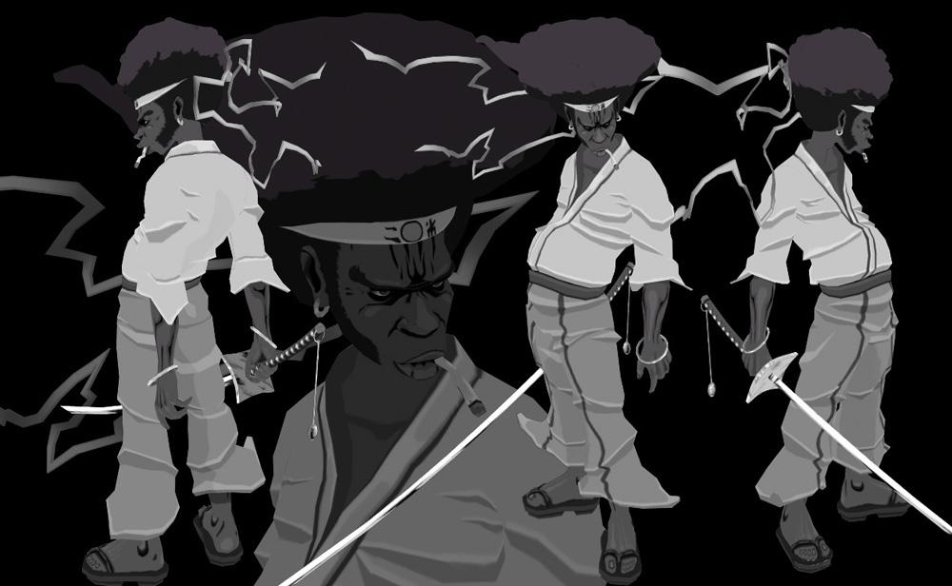
1ST GEN. AFRO
Artist: Adam Schuman
Notes:
B: 1st generation Afro by TKO has kind of a stylized toon shaded surface but the proportions and form are kind of normal.

Slide 39
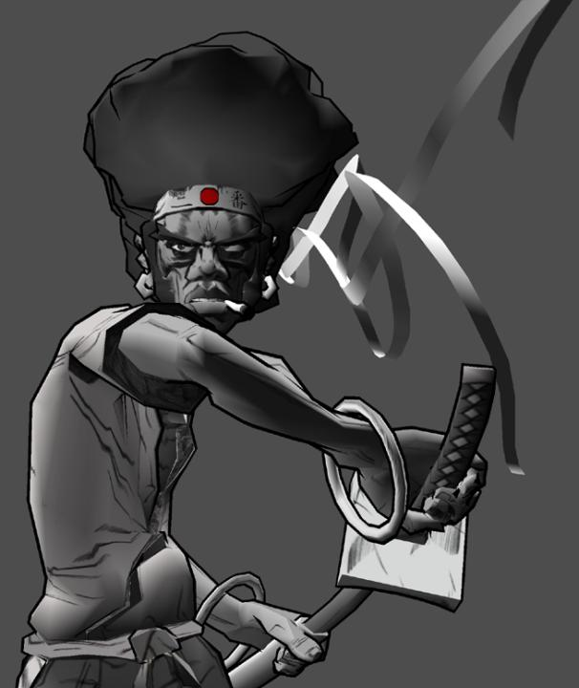
2ND GEN. AFRO
Notes:
B: 2nd generation Afro with more stylized proportions.

Slide 40
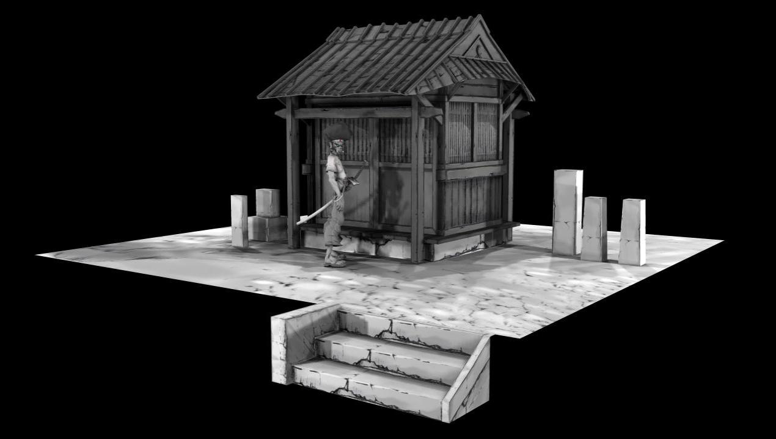
Notes:
B: A vignette to match the look.
B: There was a general nervousness about going black and white and we began playing with more color.

Slide 41
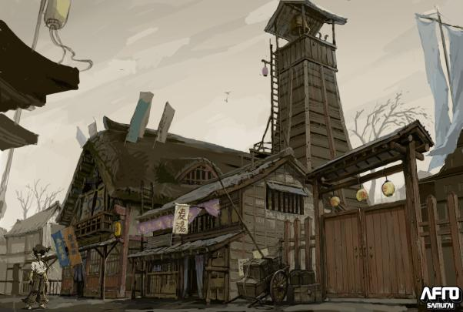
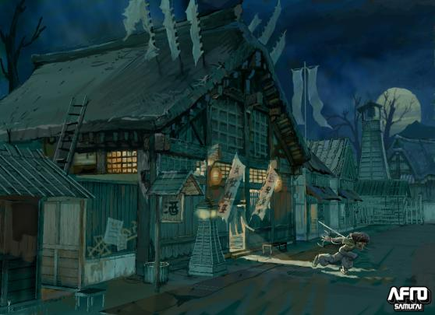
AFRO SAMURAI
PROTOTYPE CONCEPT
Notes:
B: Early environment concepts were we’re playing with color.

Slide 42
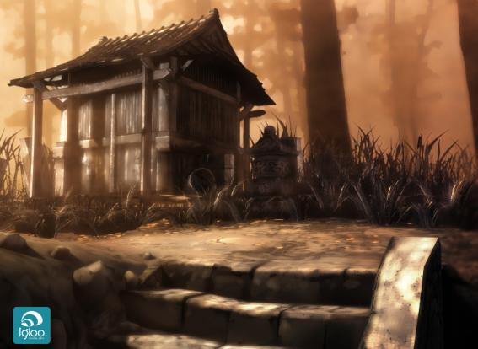
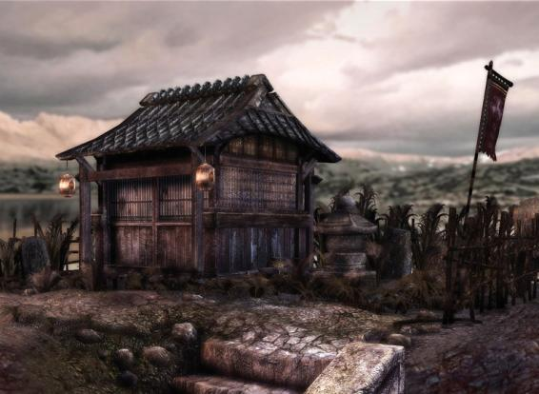
OUTSOURCING
TESTS
Notes:
B: Some color vignettes by outsourcers Igloo and Outso.

Slide 43
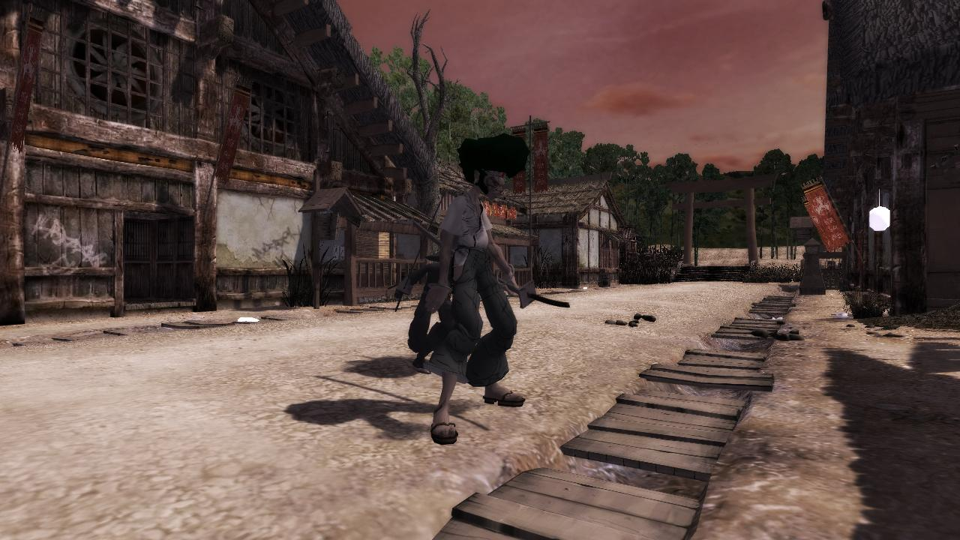
Notes:
B: At this stage prototyping had begun.
B: This is one of the first in game screen shots.

Slide 44
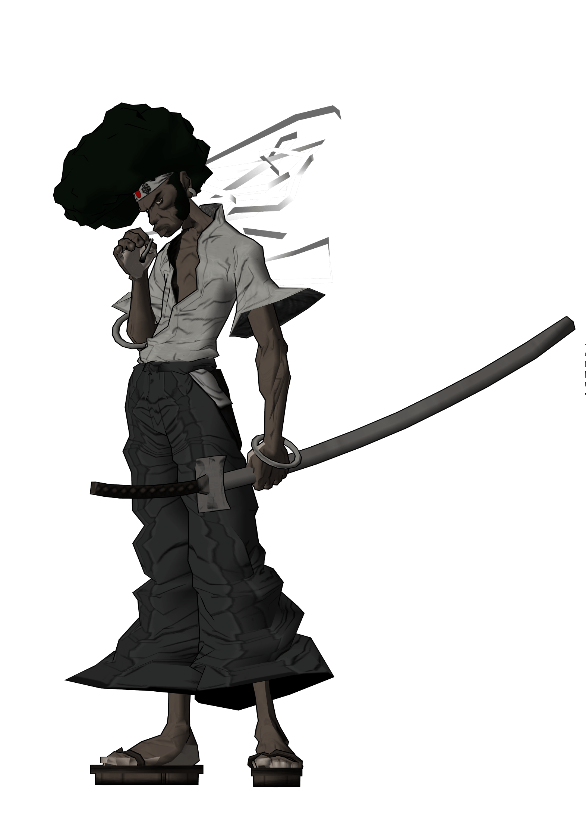
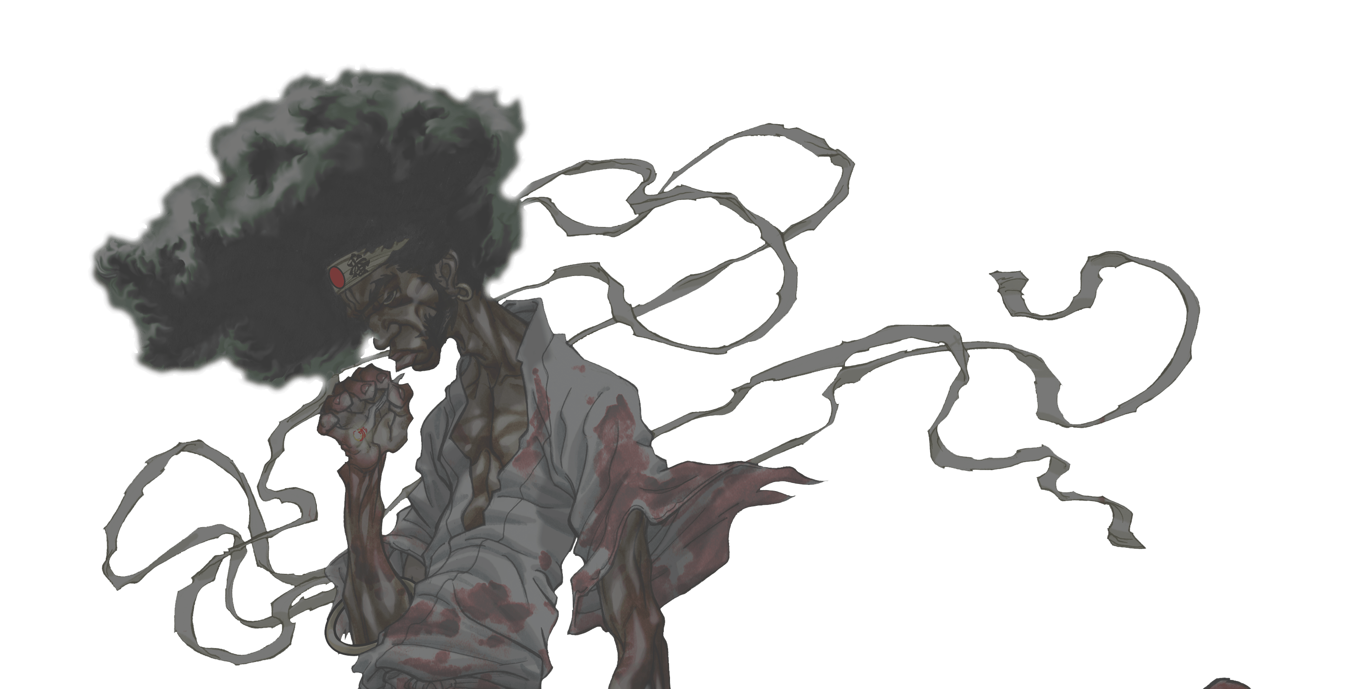
3RD GEN. AFRO
Notes:
44
B: 3rd generation Afro based off Duke Mighten’s concepts. Duke Mighten was the art director during the early stages of the project.

Slide 45
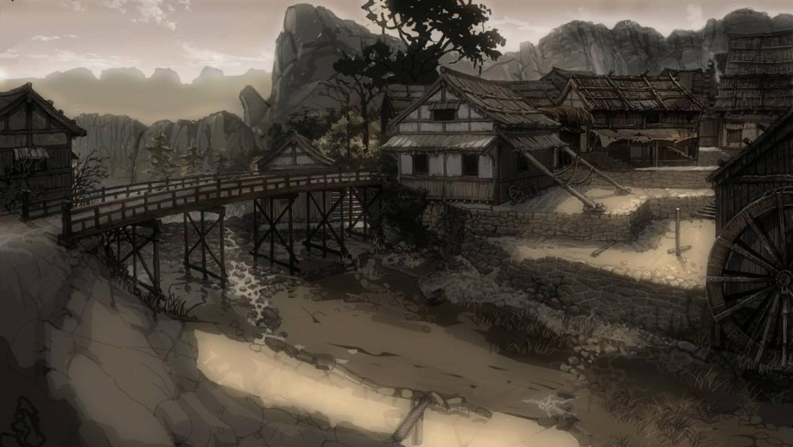
Notes:
B: This is the concept piece for our first prototype

Slide 46

Notes:
B: This is the in-game version of that piece

Slide 47


4TH GEN. AFRO
Notes:
B: 4th generation Afro.
B: At this point there was a real push to get Afro looking more “Next Gen”
B: This is the first high poly zbrush model of Afro as an attempt at getting more of a next gen look through normal maps.
B: When you start getting into high poly modeling it can be easy to get carried away with all the detailing you can do.

Slide 48
“FORM”
A
FOUNDATION
Notes:
B: So it became clear that we needed to define more specifically what it is about the form that we wanted to maintain this would be the foundation for any surfacing to come.

Slide 49

SHAPE LANGUAGE
© 2006 TAKASHI OKAZAKI, GONZO / SAMURAI PROJECT
Notes:
B: So again we went back to the source and started examining Okazaki’s work.
B: There was something unique about it besides his crazy mash up designs.
B: A kind of style language that was consistent through all his pen work.

Slide 50

ANGULARITY
© 2006 TAKASHI OKAZAKI, GONZO / SAMURAI PROJECT
Notes:
B: And what it boiled down to for us, in terms of form, was angularity.
B: He didn’t just have smoothly flowing cloth with nice curves, he had kinks and angles.

Slide 51

ANGULARITY
Notes:
B: When your using zbrush things have a tendency to come out blobby.
B: Which is the opposite of what we wanted.

Slide 52

ANGULARITY
Notes:
B: You have to be very intentional when you want angularity in zbrush.
B: So it was really important that we defined this upfront.

Slide 53



5TH GEN. AFRO
Notes:
B: 5th gen Afro with some of that angularity in the form.
B: Also in an attempt to look more “Next Gen” we started moving more towards a realistic shading model with the uber shader.

Slide 54
UBER SHADER
Notes:
D: Many development teams have something like the uber shader.
D: It’s a generic set of components that give a so-called traditional computer generated look.

Slide 55
UBERSHADER SUPPORTS:
Diffuse Map
Normal Map
Specular Map
Light Map
Decal Map
Emissive Map
Cube Map
Shadow Map
Point Lights
Spot Lights
Directional Lights
Notes:
D: Here’s a sampling of some of those components: it supported diffuse maps, decal maps, and as many lights as you wanted.
D: It’s fairly flexible but it tends to result in a look that many games had at the time: shiny, specular-heavy look.
D: Since the uber shader was generic, it was great for prototyping but was very slow in terms of GPU usage.
D: Bryan modeled Afro using the uber shader and it looked great but it also kind of looked like a...

Slide 56

Notes:
D: Creepy Puppet
D: This is a good strong model, there is a lot I like about it, but you have to see him move around on screen to really understand what I mean by creepy puppet.
D: I’m not sure if it’s applicable here, but the Uncanny Valley springs to mind. If Afro isn’t in the valley, then he’s probably trying to climb out.
D: And while it's a high quality model, I thought we could distinguish ourselves from other games by developing our own shaders.

Slide 57
TURNING POINT
Notes:
D: We knew that we had a small team and a conservative budget, we couldn't afford to compete head-on with other games.
D: So it was a necessity that we distinguish ourselves and follow our own path.
D: One meeting, I told Bryan pretty candidly what I thought and he agreed.
D: This was the turning point. We asked for some time to develop a new look for Afro.
D: We got the go ahead. We had a tight schedule so we were given two weeks.

Slide 58
TECHNIQUES
IN TWO WEEKS
Notes:
D: During these two weeks, Russ Campbell, our technical art lead, and Paul Gardner, our Design Director, worked with Bryan and I on these shader experiments. D: First, we wanted to lay down some principles to give us direction before diving into developing these shaders.

Slide 59
PRINCIPLES
QUICK PROTOTYPING
COLLABORATIVE ITERATION
FLEXIBLE COMPONENTS
HAND-CRAFTED LOOK
REPRODUCIBILITY
Notes:
D: A. Quick prototyping: We used Nvidia’s FX composer as a tool to develop and test the shaders. Once the shader looks good in FX composer, it’s pretty straightforward to get it working as a hardware shader in Maya.
D: B. Collaborative iteration: This was a collaboration between programmers and artists. Rather than construct known technology and letting that drive the look, a collaboration allows exploration of techniques off the beaten path.
D: C. Flexible components: Part of the collaborative iteration is the communication of what’s wanted by the artist and what’s possible by the programmer. Creating flexible components meant designing the “sliders” for these components to offer the greatest range of customization.
D: In the next section, Bryan is going to talk about how we achieved that hand-crafted look and
D: how we were able to reproduce it for all the characters and backgrounds.

Slide 60
CHARACTER SHADER
Notes:
B: Most of Afro's look came from two shaders, the background shader and the character shader.
B: Since we viewed this game as character driven, we decided to work on the character shader first and gave ourselves a week to come up with something.
B: We didn’t want realism but still wanted to maintain a detailed richness.

Slide 61
HAND-CRAFTED LOOK
Notes:
B: It wasn’t enough that the overall form had the element of stylization that we wanted, we needed to extend that stylization to the surface of that form.
B: Again we wanted to maintain the hand crafted look that the manga embodied.
B: We started by seeing how much of that we could get from the diffuse texture.

Slide 62


DIFFUSE
Notes:
62
B: Here is what we started with,
B: And after playing with it for a bit this is were we ended up.

Slide 63


DIFFUSE
Notes:
63
B: Once we had something that worked, we had to make it quick and easy to reproduce.

Slide 64
REPRODUCIBILITY
Notes:
B: With our current team size and schedule it became necessary to make the character textures in about a day.
B: And the look had to remain consistent across all the characters.

Slide 65
5 STEPS
Notes:
B: So we analyzed this texture and were able to break it down into five steps.

Slide 66


FLATS
Notes:
B: 1st we started by laying down the base colors. The flats.
B: This could also be used as a way of quickly selecting different parts of the texture.

Slide 67


COLOR SHIFT
Notes:
B: Next we would add the color shifting.
B: Adding some subtle reds to the skin extremeties like hands ears and nose.
B: Also darkening up the edges of clothing.

Slide 68


GRUNGE
Notes:
B: Then we would add the grunge layer using a grunge texture across the whole surface
B: and touching it up with some custom made grunge brushes.

Slide 69


OCCLUSION
Notes:
B: Then the occlusion layer.
B: This really helps to enhance the form since it was derived from the high poly mesh.

Slide 70

SKETCH MARKS
Notes:
B: And finally the sketch marks layer.

Slide 71


SKETCH MARKS
Notes:
B: Here’s how that layer looks on its own.
B: This was the most time consuming part of the process.
B: But we were able to make optimizations to this step.

Slide 72
SKETCH MARKS TECHNIQUE
Notes:
B: We came up with a photoshop action script that could get a good start and act as a kind of guide for the sketch marks.
B: Here are the steps in that script.

Slide 73

Notes:
B: We start with the normal map.
B: We apply the glowing edges filter and get this.

Slide 74

Notes:
B: This filter enhances color and brightness based off areas of high contrast.
B: We invert the image

Slide 75

Notes:
B: Then desaturate.

Slide 76

Notes:
B: and boost the levels.

Slide 77

Notes:
B: We end up with this line work that we called our “intial line work”
B: This is pretty good but we generally want the lines in areas that are recessed.

Slide 78

Notes:
B: So we use our ambient occlusion map as a kind of mask.
B: We then boost the levels.

Slide 79

Notes:
B: and subtract this from…

Slide 80
Notes:
B: This...and we get…

Slide 81

Notes:
B: This gives us a good start for free.
B: It also works as a kind of guide for the additional marks we make.

Slide 82

Notes:
B: This is the final sketch mark layer.

Slide 83
SKETCH MARKS
Notes:
B: and again this is how it looks on the mesh.
B: Now that we’ve done what we can with the diffuse texture it was time to look at what we could do with the shader.

Slide 84
FLEXIBLE RENDERING COMPONENTs
Notes:
B: So next we’re going to talk about the individual components that we used to achieve our look.
<switch>
D: None of the components are technically complicated, but they are flexible and allowed us to explore different looks quickly.
D: We’re not going to get too technical here, and many of the examples will be simplified, but if you have more detailed questions, feel free to bring them up at the end of the talk.

Slide 85
DIFFUSE
Notes:
D: First stage: diffuse texture with no lighting, any shading you see comes from ambient occlusion that’s baked in.

Slide 86
TOON RAMP COMPONENT
Notes:
D: We knew we wanted to experiment with two or three tone shading initially, basically a cel-shaded look, so
D: A toon ramp component is one of the first things we created.

Slide 87

TOON RAMP
Notes:
D: Here’s an early screenshot of a really simple toon ramp. It looks like a three tone ramp.
D: What is a toon ramp?

Slide 88






R:41
G:41
B:41
R:181
G:181
B:181
METALLIC RAMP
TRI-TONE RAMP
Notes:
D: A toon ramp is basically a way of translating lighting information from one form to another.
D: You can think of it as a function which takes some kind of lighting value, translates it and outputs that translated lighting value.
D: Here’s a simple example: you have a directional light and this sphere. The part of the sphere that is pointing most towards the light is assigned a lighting value of 1. The part of the sphere pointing away from the light is assigned a lighting value of 0. The other parts of the sphere have lighting values somewhere in between 1 and 0 based on where they point in relation to the light.
D: Now, the artist can provide a toon ramp texture that translates these values into lighting values that match his or her vision. The artist has the ability to customize how the surface responds to light.
D: On the right, we have an example of a gray scale value getting translated through the tri-tone ramp to white.
D: On the left, we have an example of a ramp that lights the side of the sphere that should be in shadow.
D: I personally like flexible components like this.
D: It gives a lot of control to the artists and doesn’t require programmer support outside of setting it up initially.
D: You can get a lot of different kinds of effects by altering the toon ramp texture.
88

Slide 89


TOON RAMP
Notes:
D: This is the final version of the toon ramp texture that we used
D: Notice, the toon ramp is not a linear ramp, that is, it’s not an even gradual transition from black to white.
D: In fact, the left edge isn’t even black and the entire right side is white.
D: This means the lighting contribution after translation will never be black.
D: And, for almost the entire hemisphere of angles pointing towards the light, the lighting contribution will be white.

Slide 90

TOON RAMP
Notes:
D: Here is a linear transition from black to white just for comparison.
D: Notice Afro looks darker in general and doesn’t have the highlights in his creases that pop.

Slide 91


TOON RAMP
Notes:
D: Here’s an extreme two tone toon ramp texture.
D: The half of Afro facing away from the light is completely black.
D: This kind of imparts an inky look to Afro.

Slide 92


TOON RAMP
Notes:
D: This ramp was used for metallic objects in Afro.
D: One thing to note is these textures are 2 dimensional, while the lighting lookup really only needs 1 dimension. So imagine these textures only really need to be 1 pixel tall.
D: But… since we have this second dimension, you could potentially use that real estate.
D: This way your toon ramp “function” effectively takes two inputs: a lighting value and whatever else you want. We didn’t do this, but you’ve got all these other pixels to explore.

Slide 93
HATCH COMPONENT
Notes:
D: Now, Bryan showed us the sketch marks in the diffuse texture but those sketch marks were static and we were looking for something hand-drawn that was dynamic.
D: So the next thing we created was a cross hatching component.

Slide 94

CHARACTER SPECIFIC HATCH TEXTURE
Notes:
D: This is an early experiment with using a character specific hatch texture.
D: The idea was to blend in this cross-hatched texture in the darker areas of the model.
D: We don’t have a screenshot of how this looked in game, but trust us, it didn’t look good.
D: Other than not looking that great, it meant we’d have to create a unique hatch texture for each character.
D: This could easily become a time and memory bottleneck, so we tried a simpler idea of using a universal hatch texture for all characters.

Slide 95

HATCH MIPS
Notes:
D: This is the universal hatch texture. Notice that the MIP levels were not auto-generated, they were hand adjusted.
D: In this way, the hatching for models in the distance wouldn’t just blur out.
95

Slide 96

HATCH
ALPHA
Notes:
D: Here is the alpha channel of our toon ramp texture
D: We determine where to blend in the hatch texture based on a lighting lookup into the alpha of the toon ramp texture.
D: We use black to denote a full blend of the hatch texture.
D: Once again, this allows artist flexibility. The hatching behavior falls under complete control of the artists.
D: Here’s a linear blend in the alpha which gives Afro a smooth shaded look.

Slide 97


HATCH
ALPHA
Notes:
D: Solid black in the alpha results in Afro being cross hatched all over.
D: In this slide, the hatching doesn’t correspond with the lighting in any way.

Slide 98

HATCH
ALPHA
Notes:
D: After tuning, this is what we ended up with.
D: You might notice that it happens to be similar but not quite the same as the toon ramp texture using for lighting lookup.

Slide 99
OUTLINE COMPONENT
Notes:
D: We decided early on that we were going to render an outline for the characters.
D: We had kind of an idea at this point that we were going for a more illustrated look, so…
D: We experimented with several different outlining techniques.

Slide 100

EXTRUSION
DISTANCE 0.1
Notes:
D: The first thing we tried was something we called extrusion/inversion.
D: It’s a traditional technique that was used long before we had vertex and pixel shaders where
D: The model vertices are pushed outwards along the vertex normals (that’s the extrusion)
D: And then the model is turned inside-out, that is, the normals are made to face inward (that’s the inversion)
D: We believe this is the kind of technique that Viewtiful Joe probably used.
D: The first time you hear about this, it’s the kind of thing that you think to yourself, “Does that really work?”
D: It does but it’s not perfect.
D: This kind of technique leads to small artifacts around certain edges. The artifacts are proportional to the distance that we extrude.
D: Here’s a small extrusion distance. It doesn’t look too bad yet.

Slide 101

EXTRUSION
DISTANCE 0.3
Notes:
D: At a greater extrusion distance, the artifacts are becoming more obvious.
D: The line width varies, in some ways nicely, in some ways less so, and…
D: Notice there is an offset of the outline away from Afro’s eyes.

Slide 102

EXTRUSION
DISTANCE 0.5
Notes:
D: Here it is at an extreme.
D: There are lots of artifacts but it’s got an inkiness to it that’s kind of interesting.
D: In any case, we were going for an illustrated look so…
D: We didn’t end up going with this specific technique.
D: The next technique that we tried out involved writing out normals and depth information to render targets and performing a full screen shader pass to detect edges.

Slide 103

BORDER
DETECTION
WEIGHT 2.0
Notes:
D: One of the values that we exposed to the artists was called border detection. This isn’t the only value but it’s the one we’ll be looking at here.
D: Here it is set to a low value.
D: Notice not all the edges are detected
D: The outlining is incomplete

Slide 104

BORDER
DETECTION
WEIGHT 7.0
Notes:
D: Here is border detection set to a moderate value.
D: Notice the outlining is more complete, but maybe it’s too complete. There are even outlines where we don’t want them.
D: Look around the eyes.

Slide 105

BORDER
DETECTION
WEIGHT 20.0
Notes:
D: Now if we crank up border detection we’ll see that way too many lines occur.
D: So it should be apparent that border detection is something that needs to be tuned to offer the best look.
D: And it’s a bit of a balancing act, setting the value so that It renders enough edges to look like a complete outline but not too many.
D: At any border detection value, we found that there was always a small problem with noisy edges, much like the dotted lines you see in this slide.
D: This specific effect was ok but we decided to move on.

Slide 106
OUTLINE PASS
VERTEX SHADER PSEUDO CODE
screenNormal.xyz = InverseTransposeLocal2Projection * vertexNormal.xyz
normalize(screenNormal)
offset.xy = screenNormal.xy * scale
position.xy += offset.xy * fade
Notes:
D: The method we settled on we learned from Namco Bandai Japan.
D: That’s one of the advantages of working in a large multi-national company.
D: Techniques that are well-known in Japan may not be as well-known here in the States.
D: Having good communication between the offices led to us learning about a variation on the extrusion/inversion technique.
D: The technique we settled on we called Screen-Space Outlining
D: The only difference to the extrusion/inversion technique mentioned before is it involves projecting the vertex normal to the screen before performing the extrusion.
106

Slide 107

FINAL
OUTLINE
Notes:
D: This is the result of Screen-Space Outlining and it’s what we settled on.
D: Because the normals are projected to screen space before extrusion, we have precise and consistent control over line width.
D: Notice here the line width is even. It’s a lot cleaner looking than the previous two techniques.

Slide 108
EDGE LIGHT COMPONENT
Notes:
D: Afro was looking pretty good at this point, but he had the potential of getting lost in the background.
D: Bryan wanted a way to make Afro pop and he suggested using an edge light to do this.

Slide 109
SHORTENED
PSEUDO-SHADER CODE
lightCoeff = dot(lightDir, normalInWorld)
viewCoeff = 1 - dot(normalInWorld, normalizedPosToCamera))
edgeCoeff = lightCoeff * viewCoeff
edgeLight = lightColor * edgeCoeff
Notes:
D: Here’s some pseudo code.
D: This pseudo code doesn’t include all the math. It’s been simplified down.
D: Basic idea is that edge light is stronger when the normal is perpendicular to the view and it’s also stronger when the normal is facing away from the light.
D: So the edge light is strongest when we satisfy both these conditions.
D: We’re going to do a quick run-through of different edge light intensities and colors.
109

Slide 110
EDGE LIGHT
Notes:
D: Here’s Afro with no edge light. He doesn’t look too bad.

Slide 111

EDGE LIGHT
Notes:
D: Here’s a subtle white edge light.
D: Afro seems to pop just a little from the background here.
D: [return to last slide to show difference]

Slide 112

EDGE LIGHT
Notes:
D: Here’s a bright white edge light.
D: Afro pops even more.

Slide 113

EDGE LIGHT
Notes:
D: We also had a HUD-less design so it was imperative that we find a way to display Afro’s health without resorting to meters.
D: Here’s an example of a red edge light, used to indicate low health.
D: It was a cheap way of conveying Afro getting bloody.

Slide 114

EDGE LIGHT
Notes:
D: This is what Afro would look like when he’s almost dead.
D: Notice the edge lighting isn’t just applied to the edge of Afro’s silhouette. That would actually be more of a proper edge light, but this method was less expensive and served our purposes.

Slide 115

Notes:
D: Here’s Afro generated through FX Composer.
D: This would become our target reference for an in-game Afro.
D: The shaders used in FX Composer were basically the same shaders we used in-game.

Slide 116

Notes:
D: This is the final in-game Afro.

Slide 117
BACKGROUND SHADER
Notes:
D: We finished working on the character after a week and turned our attention to the background shader.
D: The background shader ended up being pretty much the same as the character shader except
D: It doesn’t have edge lighting
D: It has a per-pixel light scattering component

Slide 118

LIGHT SCATTERING
OFF
Notes:
D: Here’s the background shader without light scattering.
D: It makes a subtle but important difference when we turn on light-scattering.
118

Slide 119

LIGHT SCATTERING
ON
Notes:
D: Ambience, depth, atmosphere
119

Slide 120

LIGHT SCATTERING
EXTINCTION AND IN-SCATTERING
Extinction
In-scattering
Particle
Afro
color = color * extinction + in-scattering
Notes:
D: Here’s a technical diagram of light-scattering.
D: Basically light bounces off particles in the air
D: So we get extinction when light destined for Afro’s disbelieving eyes is bounced away
D: And we get in-scattering when random light is bounced into Afro’s traumatized eyes
D: The final math behind light scattering is pretty straightforward.
D: Basically the color is darkened by the extinction coefficient and lightened by the in-scattering.
D: Both these coefficients are view-dependent.
D: Now, one problem, since characters and dynamic objects don’t have per-pixel light scattering, they tended to clash with the background
120

Slide 121

Notes:
D: This is a shot of the Red Gate in Kuma’s level.
D: It happens to be a prop that’s animated to come crashing to the ground.
D: Since it’s a prop, it doesn’t have per-pixel light scattering and so it stands out from the rest of the level which makes aggressive use of light scattering.

Slide 122

Notes:
D: This is the Red Gate with per-prop light scattering turned on. This just means there is one extinction value and one in-scattering value used for the entire prop.
D: This is one of those trade-offs.
D: The idea is that props are small relative to the background and didn’t need per-pixel light scattering to look good.

Slide 123
SUMMARY
DISTINGUISH YOURSELF (IT’S EASIER THAN YOU THINK)
EXPERIMENT AND THROW AWAY
MOVE FAST IN SMALL TEAMS
LICENSORS CAN BE COOL
Notes:
D: We learned some important lessons from this process
D: Distinguish Yourself – It’s easier than you think. It’s easy to fall into the trap of following other games. Once we committed to creating something new, it didn’t take much time to execute.
D: B and C: Experiment and throw away and move fast in small teams kind of go together.
D: Each iteration or experiment could easily require a couple days of work.
D: The experiments were not always successful though and we would throw them away and move on.
D: It’s easier to do this kind of iteration with a small team, there’s less of that communication overhead. And there’s less of a design by committee, where everyone needs to agree on something before starting work on it. We were able to explore more because of our small team.
D: Last but not least, licensors can be cool. Gonzo let us run with Afro, they trusted us and this is one of those intangibles, something that inspired pride in our work.

Slide 124


© 2006 TAKASHI OKAZAKI, GONZO / SAMURAI PROJECT
Notes:
D: On the left is quintessential Okazaki.
D: On the right is our homage to Okazaki. Although it looks hand-drawn, it’s actually a render. It ended up being our cover.
124

Slide 125
QUESTIONS AND ANSWERS
SPECIAL THANKS TO PAUL GARDNER
DCHAN@EA.COM
BJOHNSTON@NAMCO.COM
Notes:
Special thanks to Paul Gardner, our Design Director, for all his help in putting this presentation together.
Questions?

